Slide 1
Evaluating the performance of a Classifier

Slide 2
The accuracy of a classifier on a given test set is the percentage of test set tuples that are correctly classified by the classifier.
It is also referred to as the overall recognition rate of the classifier, it reflects how well the classifier recognizes tuples of the various classes.
The error rate or misclassification rate of a classifier, M, is simply 1 - Acc(M), where Acc(M) is the accuracy of M.
If we are using the training set to estimate the error rate of a model, this quantity is known as the resubstitution error.
The confusion matrix is a useful tool for analyzing how well your classifier can recognize tuples of different classes.

Slide 3
CONFUSION MATRIX
A confusion matrix is a table that describes the performance of a classification model by showing the actual versus predicted classifications.
It includes:
True Positives (TP): Correctly predicted positive instances.
True Negatives (TN): Correctly predicted negative instances.
False Positives (FP): Incorrectly predicted positive instances (Type I error).
False Negatives (FN): Incorrectly predicted negative instances (Type II error).
From the confusion matrix, several performance metrics can be derived.
Accuracy, Precision, Recall, F1-Score, Specificity,Sensitivity
The table may have additional rows or columns to provide totals or recognition rates per class.

Slide 4
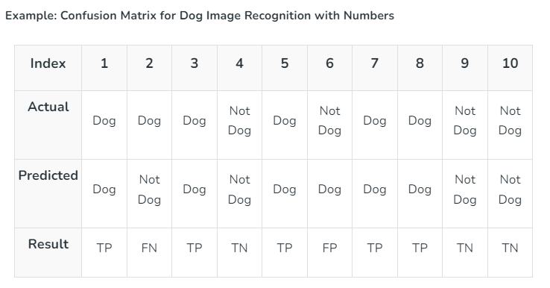
Actual Dog Counts = 6
Actual Not Dog Counts = 4
True Positive Counts = 5
False Positive Counts = 1
True Negative Counts = 3
False Negative Counts = 1

Slide 5
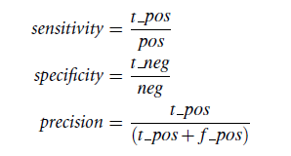

How well the classifier can recognize the positive tuples and how well it can recognize the negative tuples.
Sensitivity , also referred to as the true positive (recognition) rate,is the proportion of positive tuples that are correctly identified.
Specificity is the true negative rate, the proportion of negative tuples that are correctly identified.
Precision - the ratio of true positive predictions to the total number of positive predictions made by the model.
t_pos is the number of true positives
pos is the number of positive (“cancer”) tuples
t_neg is the number of true negatives tuples
that were correctly classified
neg is the number of negative tuples
f_pos is the number of false positives tuples
that were incorrectly labeled

Slide 6
CONFUSION MATRIX
The true positives, true negatives, false positives, and false negatives are also useful in assessing the costs and benefits (or risks and gains) associated with a classification model.
The cost associated with a false negative is far greater than that of a false positive.(Eg: cancer detection)
Similarly, the benefits associated with a true positive decision may be different than that of a true negative. (loan application)

Slide 7
Are there cases where accuracy may not be appropriate?
A common assumption is that all tuples are uniquely classifiable.
There is a wide diversity of data in large databases.
Not always reasonable to assume that all tuples are uniquely classifiable.
It is more probable to assume that each tuple may belong to more than one class.
Accuracy measure is not appropriate, because it does not take into account the possibility of tuples belonging to more than one class.
It is useful to return a probability class distribution than a single class label.
Accuracy measures may use a second guess heuristic.

Slide 8
Evaluating the Accuracy of a Classifier
Holdout Method and Random Subsampling
Cross-validation
Bootstrap Method

Slide 9
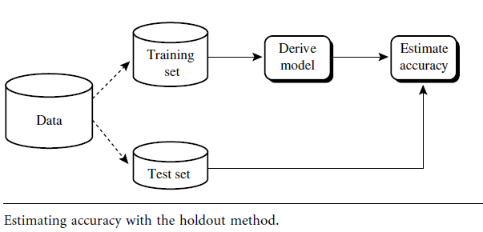
Holdout Method
The Holdout Method involves dividing the dataset into two main subsets:
Training Set: Used to train the model.
Testing Set: Used to evaluate the model's performance on unseen data
Steps Involved
Split the Data:
Training Set: Typically, 60% to 80% of the data.
Testing Set: Typically, 20% to 40% of the data.
The exact proportion can vary depending on the
size of the dataset and specific requirements of
the task.
Train the Model:
Fit the machine learning model using the training set.
Evaluate the Model:
Assess the model's performance using the testing set.

Slide 10
Holdout Method
Advantages
Simplicity: Easy to implement and understand.
Speed: Quick evaluation since the model is only trained and tested once.
Disadvantages
Variance in Results: The performance estimate can vary depending on how the data is split. Different splits might lead to different performance metrics.
Potential for Data Leakage: If not done properly, the model might accidentally be exposed to testing data during training.

Slide 11
Random Subsampling
The dataset is randomly divided into a training set and a testing set multiple times.
Each split is independent of the others.
The model is trained and evaluated on each of these splits, and the performance metrics are averaged to provide a final estimate.

Slide 12
Random Subsampling
Steps Involved
Random Splitting:
Randomly divide the dataset into two subsets: a training set and a testing set. The proportion of data in each subset can vary depending on the specific use case.
Model Training and Evaluation:
Train the model on the training set.
Evaluate the model on the testing set.
Record the performance metrics (e.g., accuracy, precision, recall).
Repeat:
Repeat the random splitting, training, and evaluation process multiple times.
Aggregate Results:
Compute the average of the performance metrics across all iterations to obtain a final performance estimate.

Slide 13
Random Subsampling
Advantages
Flexibility: Can be easily adapted to different proportions of training and testing data.
Robustness: Reduces the risk of overfitting or underfitting associated with a single train-test split by averaging results over multiple splits.
Disadvantages
Computational Cost: Can be computationally expensive since the model needs to be trained and evaluated multiple times.
Variance: Performance estimates can still have variance depending on how the data is split.

Slide 14
Cross-validation
In k-fold cross-validation, the initial data are randomly partitioned into k mutually exclusive subsets or “folds,” D1, D2, …. , Dk, each of approximately equal size.
Training and testing is performed k times.
In iteration i, partition Di is reserved as the test set, and the remaining partitions are collectively used to train the model.
That is, in the first iteration, subsets D2, ….. , Dk collectively serve as the training set in order to obtain a first model, which is tested on D1; the second iteration is trained on subsets D1, D3, … , Dk and tested on D2; and so on.
Each sample is used the same number of times for training and once for testing.
For classification, the accuracy estimate is the overall number of correct classifications from the k iterations, divided by the total number of tuples in the initial data.
For prediction, the error estimate can be computed as the total loss from the k iterations, divided by the total number of initial tuples.

Slide 15
Variations of Cross validation
Leave-one-out is a special case of k-fold cross-validation where k is set to the number of initial tuples.
That is, only one sample is “left out” at a time for the test set.
In stratified cross-validation, the folds are stratified so that the class distribution of the tuples in each fold is approximately the same as that in the initial data.
In general, stratified 10-fold cross-validation is recommended for estimating accuracy due to its relatively low bias and variance.

Slide 16
Bootstrap Method
The bootstrap method samples the given training tuples uniformly with replacement.
That is, each time a tuple is selected, it is equally likely to be selected again and readded to the training set.
A commonly used one is the .632 bootstrap.

Slide 17
.632 bootstrap
Suppose we are given a data set of d tuples.
The data set is sampled d times, with replacement, resulting in a bootstrap sample or training set of d samples.
It is very likely that some of the original data tuples will occur more than once in this sample.
The data tuples that did not make it into the training set end up forming the test set.
Suppose we were to try this out several times.
On an average, 63.2% of the original data tuples will end up in the bootstrap, and the remaining 36.8% will form the test set .

Slide 18

Bootstrap Method
We can repeat the sampling procedure k times.
In each iteration, we use the current test set to obtain an accuracy estimate of the model obtained from the current bootstrap sample.
The overall accuracy of the model is then estimated as
where Acc(M_{i})_{test_set} is the accuracy of the model obtained with bootstrap sample i when it is applied to test set i.
Acc(M_{i})_{train_set} is the accuracy of the model obtained with bootstrap sample i when it is applied to the original set of data tuples.
The bootstrap method works well with small data sets.

Slide 19
Ensemble Methods—Increasing the Accuracy
Ensemble methods leverage the principle that combining several models (learners) can reduce errors by averaging out their biases and variances.
The key is to use diverse models or predictions, which can provide different perspectives on the data.

Slide 20
Types of Ensemble Methods
Bagging (Bootstrap Aggregating)
Concept: Combines predictions from multiple models trained on different subsets of the data.
Each subset is obtained by resampling the original dataset with replacement.
How It Works:
Create multiple bootstrap samples from the training data.
Train a model (e.g., decision tree) on each bootstrap sample.
Aggregate the predictions by averaging (for regression) or majority voting (for classification).
Example: Random Forest is a popular bagging method using decision trees.

Slide 21
Types of Ensemble Methods
Boosting
Concept: Combines multiple models sequentially, where each model corrects the errors of its predecessor.
The models are trained in sequence, with each model focusing on the examples that previous models got wrong.
How It Works:
Train an initial model on the data.
Train subsequent models that correct the errors of the previous models by giving more weight to misclassified examples.
Combine the models' predictions using weighted averaging.
Example: Gradient Boosting Machines (GBM), AdaBoost, XGBoost, LightGBM.

